Slide 1
AI

Slide 2
Artificial Intelligence
Language and Logic

Slide 3
Natural Language Text is Everywhere
Today’s person is subjected to more information in a day than a person in the middle ages in a lifetime
The search engine market is $94B a year
Feb 2016, New York Times
Siri Gets 1 Billion requests a week
Jan 2016, USA Today, citing Apple
Users send out 168 Million emails every minute
2015, go-globe.com
Google indexes at least 48 Billion web pages
2016, WorldWideWebSize.com
Twitter posts 400 Million tweets per day
2012, Dick Costolo, CEO of Twitter
Google performs 1 Billion automatic translations per day
2016, Cnet.com
Notes:
Jinha 2010 – one paper per minute
http://www.telegraph.co.uk/news/science/science-news/8316534/Welcome-to-the-information-age-174-newspapers-a-day.html
Say something about multilingual texts

Slide 4
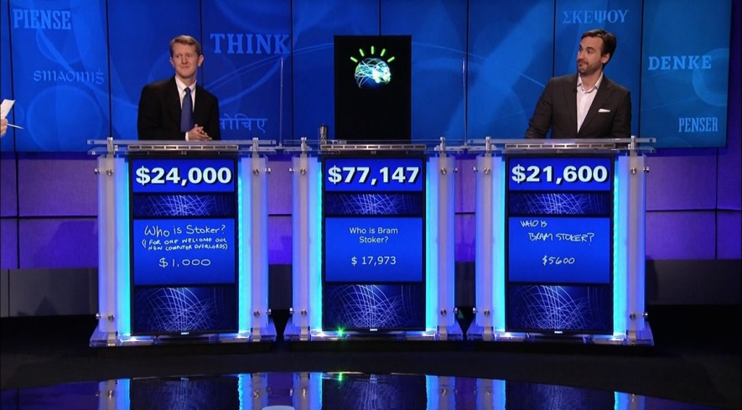
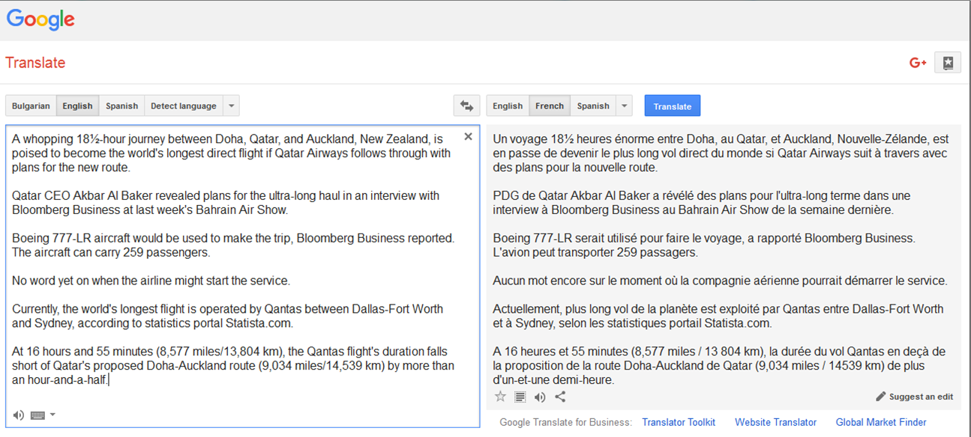

NLP Systems
Notes:
What is NLP?
"The antagonist of Stevenson's Treasure Island." (Who is Long John Silver?)

Slide 5
The NLP Pipeline
DET N VBD DET N PRP DET N
The girl ate the omelet with a fork.

Slide 6
Constituent Parsing
S
NP
VP
DET
N
VBD
NP
PP
The
girl
ate
DET
N
PRP
NP
the
omelet
with
DET
N
a
fork
Notes:
JM?

Slide 7
Dependency Parsing
ROOT
root
ate
nsubj
dobj
nmod
girl
omelet
fork
det
det
det
case
the
the
a
with
Notes:
Remove?

Slide 8
Language Understanding
Semantic Analysis
Girl (g₁)
Omelet (o₁)
Fork (f₁)
Eating (e₁)∧Eater (e₁,g₁)∧Eaten (e₁,o₁)∧Instrument (e₁,f₁)
World Knowledge
Omelet (X)⇒Food (X)
Inference
Hungry (Z,t₀)∧Eater (e₁,Z)∧Eaten (e₁,Y)∧Time (e₁,t₁)∧Food (Y)∧Precedes (t₀,t₁)⇒¬Hungry (Z,t₁)
Conclusion
¬Hungry (g₁,t₁)
Notes:
importance of relations
importance of similarity

Slide 9
Modern Methods for NLP
Vector Semantics
Dimensionality Reduction
Compositionality
Supervised Learning
Deep Neural Networks
Learning Architectures
RNN, LSTM, CNN
Attention-based Models
Generative Adversarial Networks
Reinforcement Learning
Off the shelf libraries

Slide 10
Artificial Intelligence
Semantics (from 3.6.1)

Slide 11
Syntax vs. Semantics
Paraphrases
John broke the window
The window was broken by John
The breaking of the window by John
Python expression
5/2 = ?

Slide 12
Semantics
What is the meaning of: (5+2)*(4+3)?
Parse tree
49
E
E
F
E
E
F
E
*
E
F
E
N
+
N
N
+
N
5
2
4
3

Slide 13
Semantics
What if we had (5+2)*(4+z)?
mult(add(5,2),add(4,z))
E
E
F
E
E
F
E
*
E
F
E
N
+
N
N
+
N
5
2
4
z

Slide 14
What about (English) sentences?
Every human is mortal.
??

Slide 15
Representing Meaning
Goal
Capturing the meaning of linguistic utterances using formal notation
Linguistic meaning
“It is 8 pm”
Pragmatic meaning
“It is time to leave”
Semantic analysis:
Assign each word a meaning
Combine the meanings of words into sentences
I bought a book: ∃ x,y: Buying(x) ^ Buyer(speaker,x) ^ BoughtItem(y,x) ^ Book(y)
Buying (Buyer=speaker, BoughtItem=book)

Slide 16
Understanding Meaning
If an agent hears a sentence and can act accordingly, the agent is said to understand it
Example
Leave the book on the table
Understanding may involve inference
Maybe the book is wrapped in paper?
And pragmatics
Which book? Which table?
So, understanding may involve a procedure

Slide 17
Artificial Intelligence
8.3.2 Propositional Logic (Chapter 7: part 2)

Slide 18
Models and Formulas
Variables
E.g., A, B
Models
assignment of truth values
Formulas
A->B matches three possible models: (0,0), (0,1), (1,1)
Knowledge base
Tell: add to the knowledge base (e.g., A=1)
Ask: query the knowledge base (e.g., A=?)

Slide 19
Clauses
Definite clauses
p ∧ q ∧ r → s (implication form)
¬p ∨ ¬q ∨ ¬r ∨ s (disjunctive form)
Horn clauses
Either definite clauses
Or “goal clauses”:
p ∧ q ∧ r → false
¬p ∨ ¬q ∨ ¬r ∨ ¬s

Slide 20
Propositional logic: Syntax
Propositional logic is the simplest logic – illustrates basic ideas
The proposition symbols P₁, P₂ etc are sentences
If S is a sentence, ¬S is a sentence (negation)
If S₁ and S₂ are sentences, S₁ ∧ S₂ is a sentence (conjunction)
If S₁ and S₂ are sentences, S₁ ∨ S₂ is a sentence (disjunction)
If S₁ and S₂ are sentences, S₁ ⇒ S₂ is a sentence (implication)
If S₁ and S₂ are sentences, S₁ ⇔ S₂ is a sentence (biconditional)

Slide 21
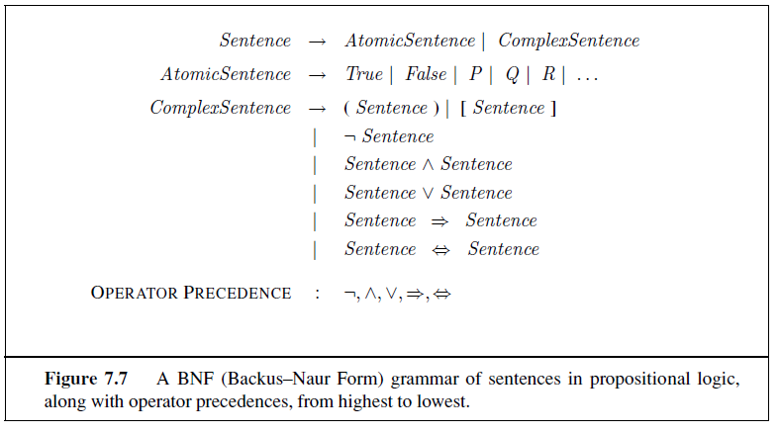

Slide 22
Translating propositions to English
A = Today is a holiday.
B = We are going to the zoo.
B ⇒ A
A ∧ ¬ B
¬ A ⇒ B
¬ B ⇒ A
B ⇒ A

Slide 23
Translating propositions to English
A = Today is a holiday.
B = We are going to the zoo.
B ⇒ A
If we are going to the zoo, then today is a holiday.
A ∧ ¬ B
Today is a holiday and we are not going to the zoo.
¬ A ⇒ ¬ B
If today is not a holiday, then we are not going to the zoo.
¬ B ⇒ ¬ A
If we are not going to the zoo, then today is not a holiday.
B ⇒ A
If we are going to the zoo, then today is a holiday.

Slide 24
Propositional logic: Semantics
Each model specifies true/false for each proposition symbol
E.g. P_{1,2} P_{2,2} P_{3,1}
false true false
With these symbols, 8 possible models, can be enumerated automatically.
Rules for evaluating truth with respect to a model m:
¬S is true iff S is false
S₁ ∧ S₂ is true iff S₁ is true and S₂ is true
S₁ ∨ S₂ is true iff S₁is true or S₂ is true
S₁ ⇒ S₂ is true iff S₁ is false or S₂ is true
i.e., is false iff S₁ is true and S₂ is false
S₁ ⇔ S₂ is true iff S₁⇒S₂ is true andS₂⇒S₁ is true
Simple recursive process evaluates an arbitrary sentence, e.g.,
¬P_{1,2} ∧ (P_{2,2} ∨ P_{3,1}) = true ∧ (true ∨ false) = true ∧ true = true

Slide 25
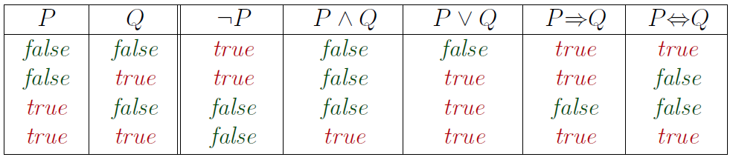
Truth tables for connectives

Slide 26
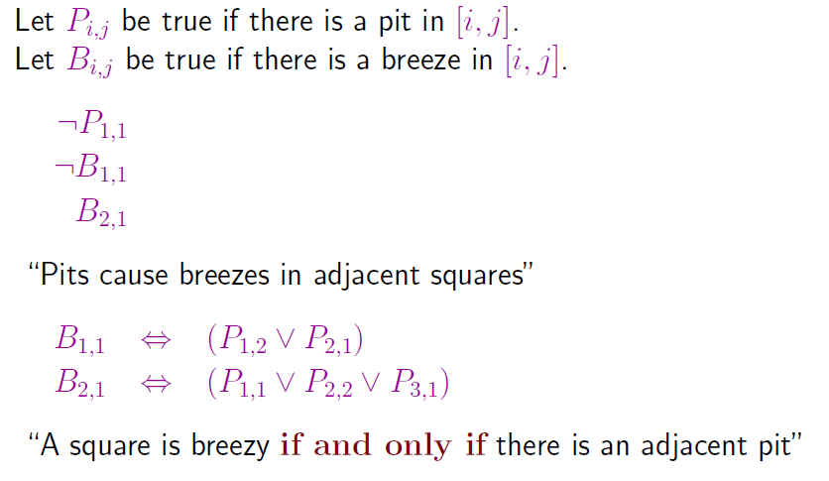
Wumpus world sentences

Slide 27
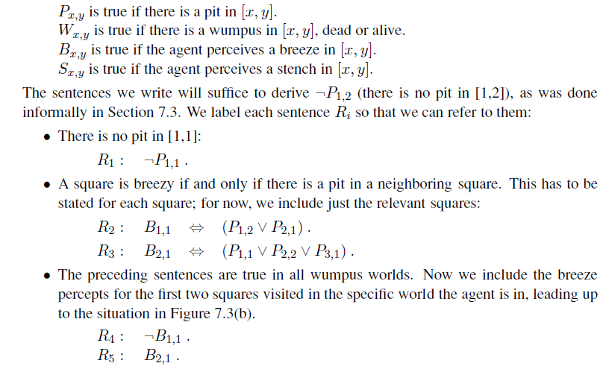

Slide 28
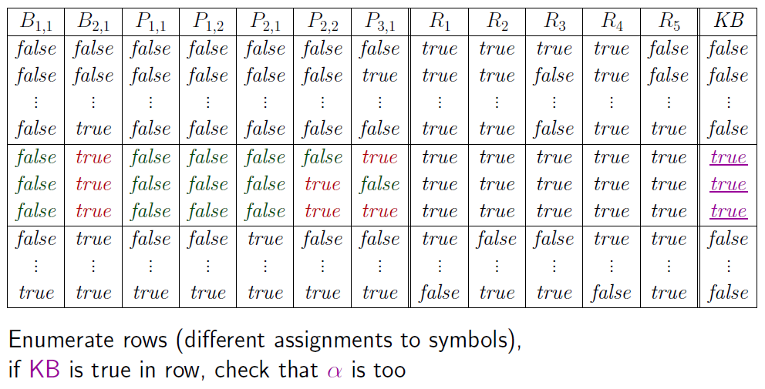
Truth tables for inference

Slide 29
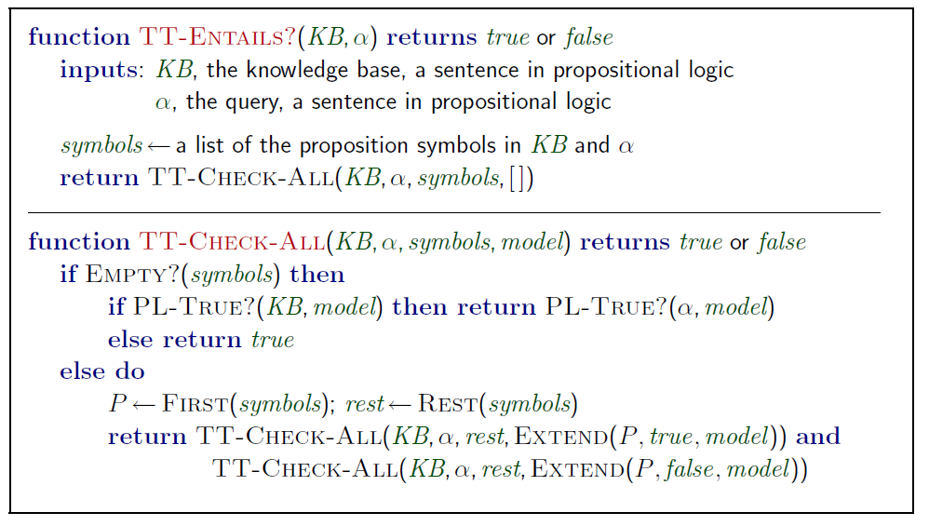
Inference by enumeration
Depth-first enumeration of all models is sound and complete
For n symbols, time complexity is O(2^{n}), space complexity is O(n)

Slide 30
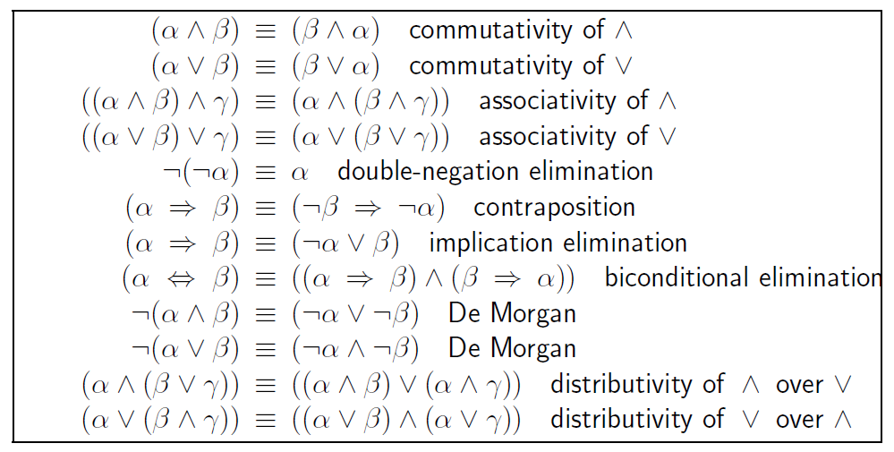
Logical equivalence
Two sentences are logically equivalent iff true in same models: α ≡ ß iff α╞ β and β╞ α

Slide 31
Validity and satisfiability
A sentence is valid if it is true in all models,
e.g., True, A ∨¬A, A ⇒ A, (A ∧ (A ⇒ B)) ⇒ B
Validity is connected to inference via the Deduction Theorem:
KB ╞ α if and only if (KB ⇒ α) is valid
A sentence is satisfiable if it is true in some model
e.g., A∨ B, C
A sentence is unsatisfiable if it is true in no models
e.g., A∧¬A
Satisfiability is connected to inference via the following:
KB ╞ α if and only if (KB ∧¬α) is unsatisfiable

Slide 32
Proof methods
Proof methods divide into (roughly) two kinds:
Natural Deduction: Application of inference rules
Legitimate (sound) generation of new sentences from old
Proof = a sequence of inference rule applications Can use inference rules as operators in a standard search algorithm
Typically require transformation of sentences into a normal form
Model checking
truth table enumeration (always exponential in n)
improved backtracking, e.g., Davis--Putnam-Logemann-Loveland (DPLL)
heuristic search in model space (sound but incomplete)
e.g., min-conflicts-like hill-climbing algorithms

Slide 33
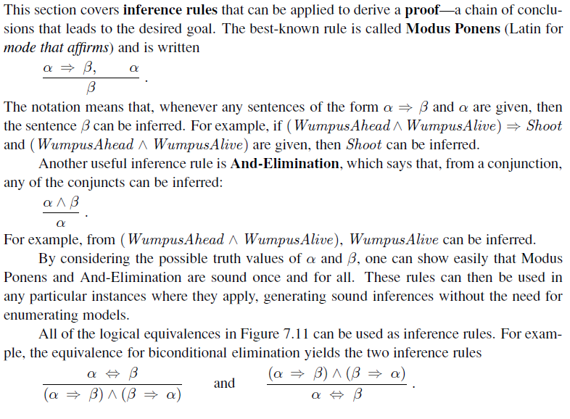

Slide 34
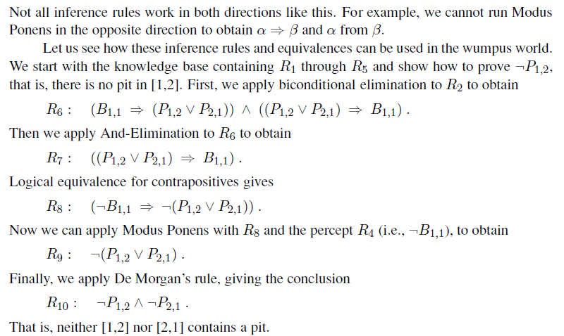

Slide 35
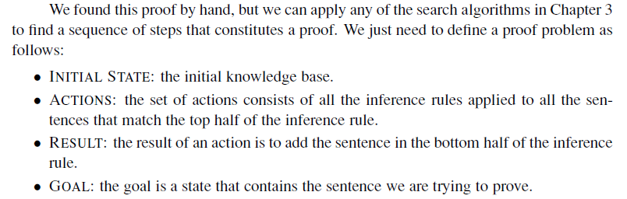

Slide 36
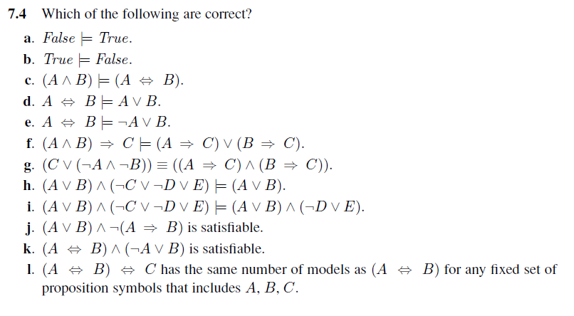

Slide 37
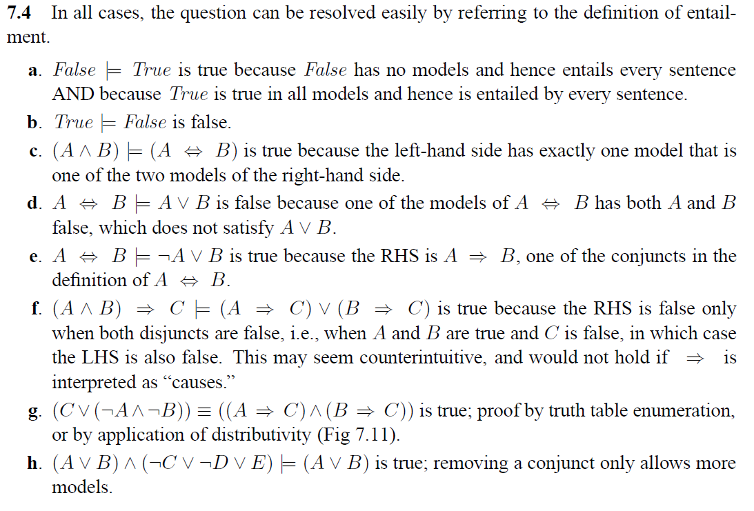

Slide 38
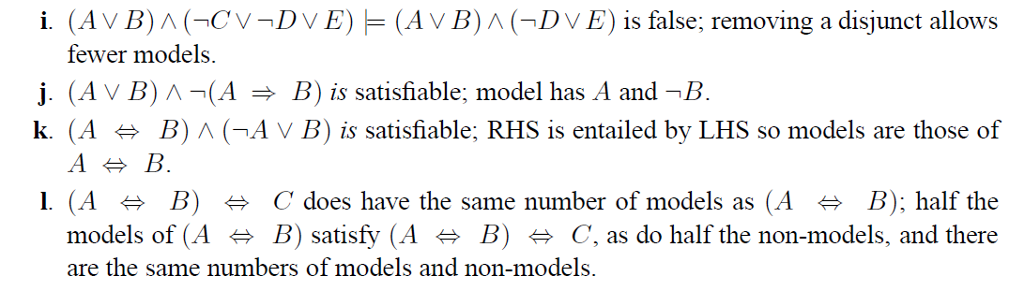

Slide 39
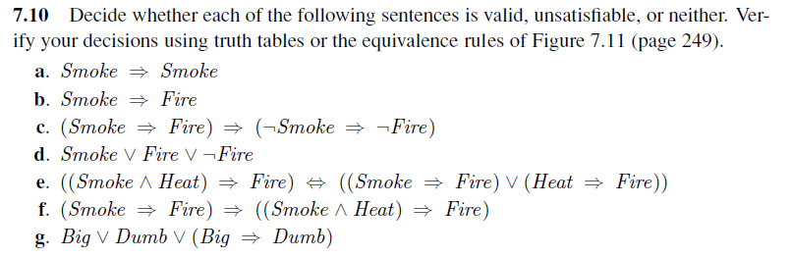

Slide 40
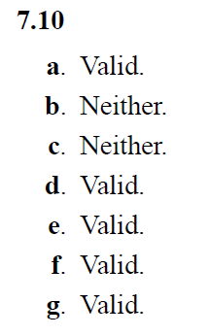

Slide 41
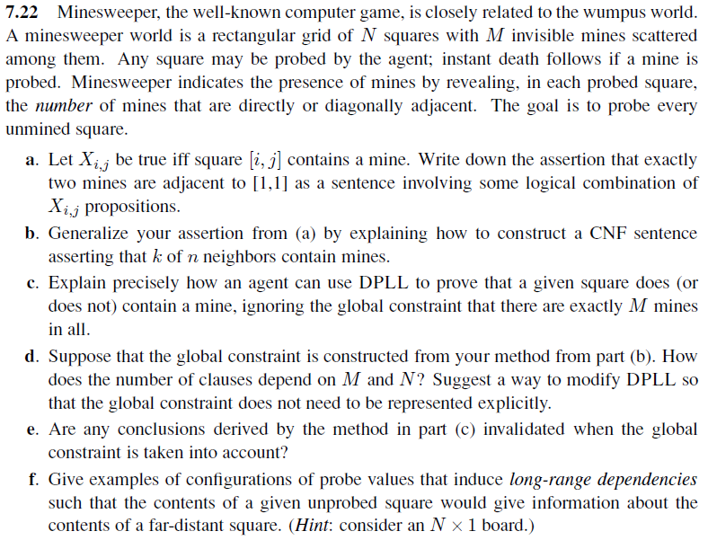

Slide 42
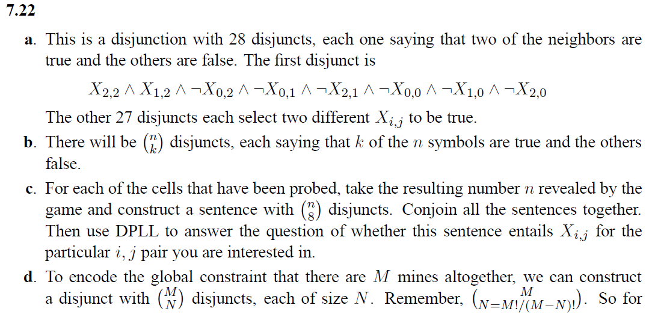
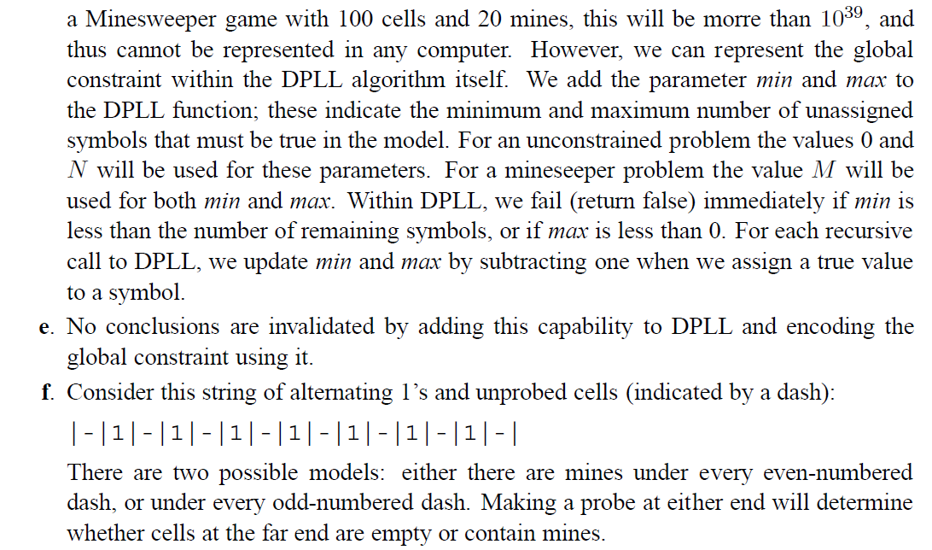

Slide 43
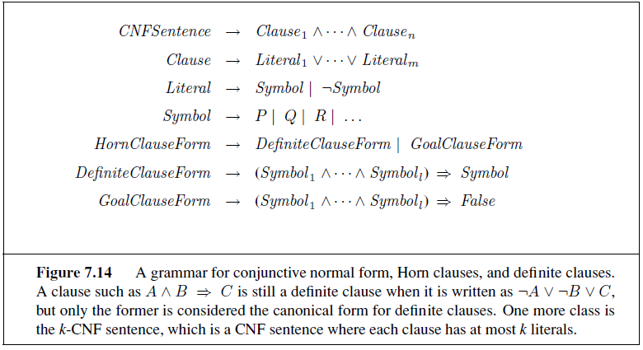
definite clause – exactly one literal is positive
Horn clause – at most one literal is positive

Slide 44
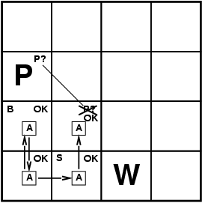
Resolution
Conjunctive Normal Form (CNF)
conjunction of disjunctions of literals
E.g., (A ∨ ¬B) ∧ (B ∨ ¬C ∨ ¬D)
Resolution inference rule (for CNF):
l_{i} ∨… ∨ l_{k}, m₁ ∨ … ∨ m_{n}
l_{i} ∨ … ∨ l_{i-1} ∨ l_{i+1} ∨ … ∨ l_{k} ∨ m₁ ∨ … ∨ m_{j-1} ∨ m_{j+1} ∨... ∨ m_{n}
where l_{i} and m_{j} are complementary literals.
E.g., P_{1,3} ∨ P_{2,2}, ¬P_{2,2} P_{1,3}
Resolution is sound and complete for propositional logic

Slide 45
Conversion to CNF
B_{1,1} ⇔ (P_{1,2} ∨ P_{2,1})
Eliminate ⇔, replacing α ⇔ β with (α ⇒ β)∧(β ⇒ α).
(B_{1,1} ⇒ (P_{1,2} ∨ P_{2,1})) ∧ ((P_{1,2} ∨ P_{2,1}) ⇒ B_{1,1})
2. Eliminate ⇒, replacing α ⇒ β with ¬α∨ β.
(¬B_{1,1} ∨ P_{1,2} ∨ P_{2,1}) ∧ (¬(P_{1,2} ∨ P_{2,1}) ∨ B_{1,1})
3. Move ¬ inwards using de Morgan's rules and double-negation:
(¬B_{1,1} ∨ P_{1,2} ∨ P_{2,1}) ∧ ((¬P_{1,2} ∨ ¬P_{2,1}) ∨ B_{1,1})
4. Apply distributivity law (∧ over ∨) and flatten:
(¬B_{1,1} ∨ P_{1,2} ∨ P_{2,1}) ∧ (¬P_{1,2} ∨ B_{1,1}) ∧ (¬P_{2,1} ∨ B_{1,1})

Slide 46
Resolution
Soundness of resolution inference rule:
¬(l_{i} ∨ … ∨ l_{i-1} ∨ l_{i+1} ∨ … ∨ l_{k}) ⇒ l_{i}
¬m_{j} ⇒ (m₁ ∨ … ∨ m_{j-1} ∨ m_{j+1} ∨... ∨ m_{n})
¬(l_{i} ∨ … ∨ l_{i-1} ∨ l_{i+1} ∨ … ∨ l_{k}) ⇒ (m₁ ∨ … ∨ m_{j-1} ∨ m_{j+1} ∨... ∨ m_{n})

Slide 47
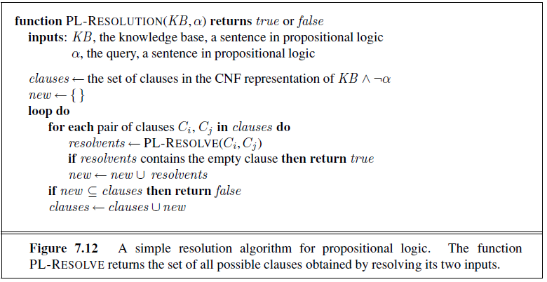
Resolution algorithm
Proof by contradiction, i.e., show KB∧¬α unsatisfiable

Slide 49
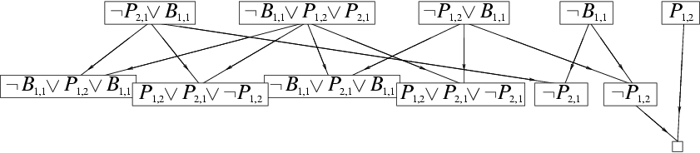
Resolution example
KB = (B_{1,1} ⇔ (P_{1,2}∨ P_{2,1})) ∧¬ B_{1,1} α = ¬P_{1,2}

Slide 50
Forward and backward chaining
Horn Form (restricted)
KB = conjunction of Horn clauses
Horn clause =
proposition symbol; or
(conjunction of symbols) ⇒ symbol
E.g., C ∧ (B ⇒ A) ∧ (C ∧ D ⇒ B)
Modus Ponens (for Horn Form): complete for Horn KBs
α₁, … ,α_{n}, α₁ ∧ … ∧ α_{n} ⇒ β
β
Can be used with forward chaining or backward chaining.
These algorithms are very natural and run in linear time

Slide 51
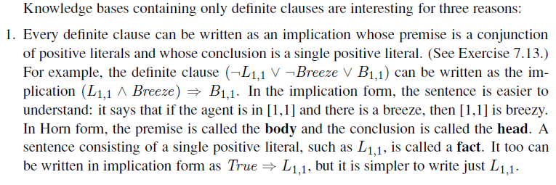
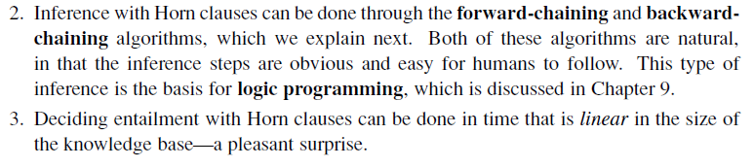

Slide 52
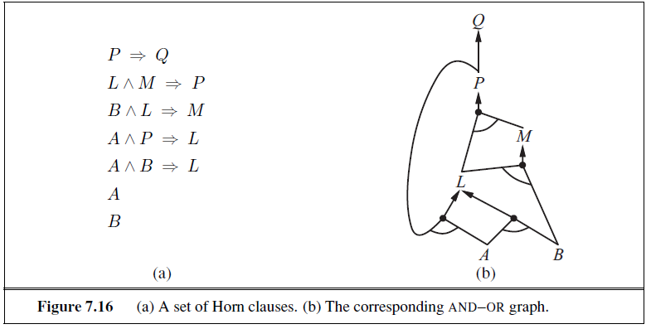
Forward chaining
Idea: fire any rule whose premises are satisfied in the KB,
add its conclusion to the KB, until query is found

Slide 53
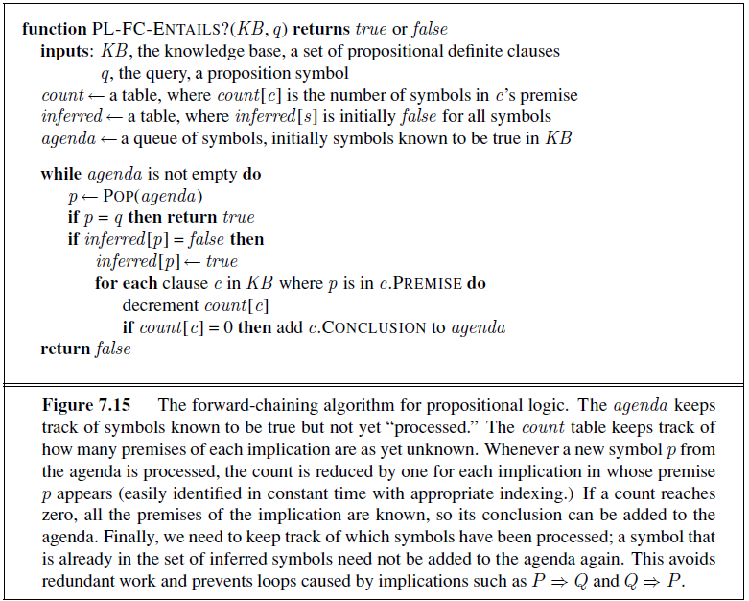
Forward chaining algorithm
Forward chaining is sound and complete for Horn KB

Slide 54
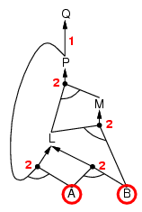
Forward chaining example

Slide 55
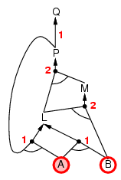
Forward chaining example

Slide 56
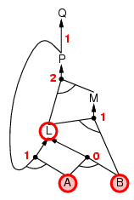
Forward chaining example

Slide 57
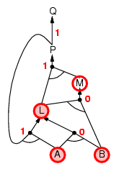
Forward chaining example

Slide 58
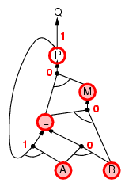
Forward chaining example

Slide 59
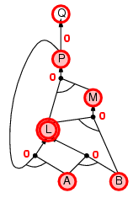
Forward chaining example

Slide 60
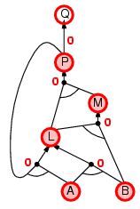
Forward chaining example

Slide 61

Forward chaining example

Slide 62
Proof of completeness
FC derives every atomic sentence that is entailed by KB
FC reaches a fixed point where no new atomic sentences are derived
Consider the final state as a model m, assigning true/false to symbols
Every clause in the original KB is true in m
a₁ ∧ … ∧ a_{k ⇒} b
Hence m is a model of KB
If KB╞ q, q is true in every model of KB, including m

Slide 63
Backward chaining
Idea: work backwards from the query q:
to prove q by BC,
check if q is known already, or
prove by BC all premises of some rule concluding q
Avoid loops: check if new subgoal is already on the goal stack
Avoid repeated work: check if new subgoal
has already been proved true, or
has already failed

Slide 64
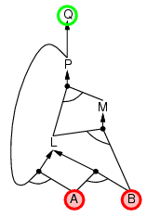
Backward chaining example

Slide 65
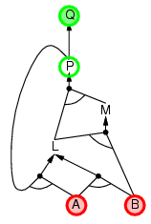
Backward chaining example

Slide 66
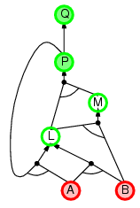
Backward chaining example

Slide 67
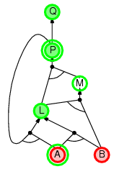
Backward chaining example

Slide 68
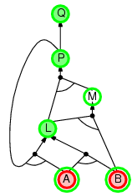
Backward chaining example

Slide 69
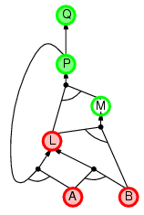
Backward chaining example

Slide 70
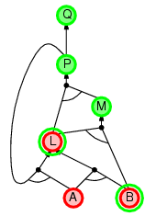
Backward chaining example

Slide 71
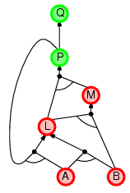
Backward chaining example

Slide 72
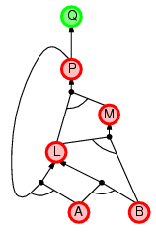
Backward chaining example

Slide 73
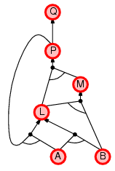
Backward chaining example

Slide 74
Forward vs. backward chaining
FC is data-driven, automatic, unconscious processing,
e.g., object recognition, routine decisions
May do lots of work that is irrelevant to the goal
BC is goal-driven, appropriate for problem-solving,
e.g., Where are my keys? How do I get into a PhD program?
Complexity of BC can be much less than linear in size of KB

Slide 75
Efficient propositional inference
Two families of efficient algorithms for propositional inference:
Complete backtracking search algorithms
DPLL algorithm (Davis, Putnam, Logemann, Loveland)
Incomplete local search algorithms
WalkSAT algorithm

Slide 76
The DPLL algorithm
Determine if an input propositional logic sentence (in CNF) is satisfiable.
Improvements over truth table enumeration:
Early termination
A clause is true if any literal is true.
A sentence is false if any clause is false.
Pure symbol heuristic
Pure symbol: always appears with the same "sign" in all clauses.
e.g., In the three clauses (A ∨ ¬B), (¬B ∨ ¬C), (C ∨ A), A and B are pure, C is impure.
Make a pure symbol literal true.
Unit clause heuristic
Unit clause: only one literal in the clause
The only literal in a unit clause must be true.

Slide 77
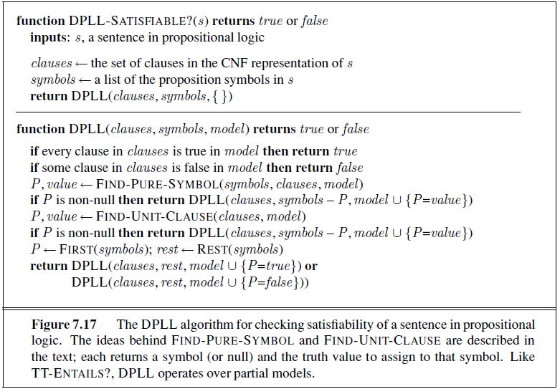
The DPLL algorithm

Slide 78
The WalkSAT algorithm
Incomplete, local search algorithm
Evaluation function: The min-conflict heuristic of minimizing the number of unsatisfied clauses
Balance between greediness and randomness

Slide 79
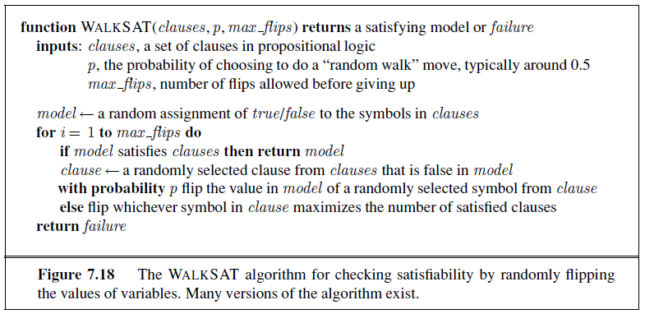
The WalkSAT algorithm

Slide 80
Hard satisfiability problems
Consider random 3-CNF sentences. e.g.,
(¬D ∨ ¬B ∨ C) ∧ (B ∨ ¬A ∨ ¬C) ∧ (¬C ∨ ¬B ∨ E) ∧ (E ∨ ¬D ∨ B) ∧ (B ∨ E ∨ ¬C)
m = number of clauses
n = number of symbols
Hard problems seem to cluster near m/n = 4.3 (critical point)

Slide 81
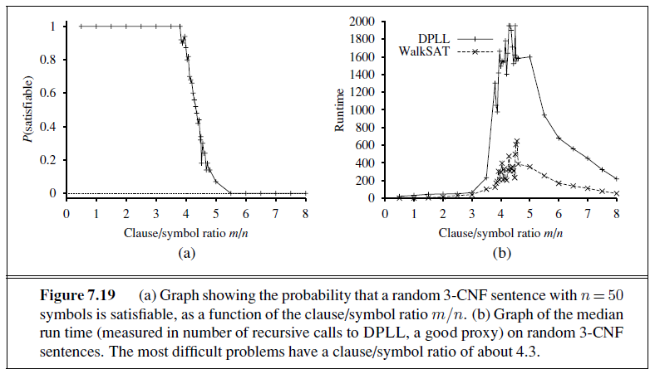
Hard satisfiability problems
Median runtime for 100 satisfiable random 3-CNF sentences, n = 50

Slide 82
Inference-based agents in the wumpus world
A wumpus-world agent using propositional logic:
¬P_{1,1}
¬W_{1,1}
B_{x,y} ⇔ (P_{x,y+1} ∨ P_{x,y-1} ∨ P_{x+1,y} ∨ P_{x-1,y})
S_{x,y} ⇔ (W_{x,y+1} ∨ W_{x,y-1} ∨ W_{x+1,y} ∨ W_{x-1,y})
W_{1,1} ∨ W_{1,2} ∨ … ∨ W_{4,4}
¬W_{1,1} ∨ ¬W_{1,2}
¬W_{1,1} ∨ ¬W_{1,3}
…
64 distinct proposition symbols, 155 sentences
Exactly one wumpus = at least one wumpus AND at most one wumpus

Slide 83
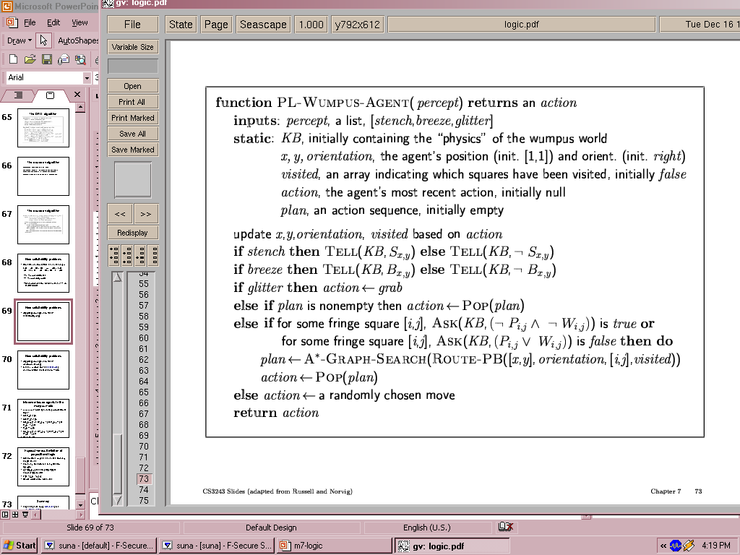

Slide 84
Additional considerations
What if there was no stench in step 3 but there is stench in step 4?
We cannot assert “stench” to the KB at step 3 since “~stench” was already asserted at step 4.
What solution is there?
Stench⁴

Slide 85
Expressiveness limitation of propositional logic
KB contains "physics" sentences for every single square
For every time t and every location [x,y],
L_{x,y} ∧ FacingRight^{t} ∧ Forward^{t} ⇒ L_{x+1,y}
Rapid proliferation of clauses
t
t

Slide 86
Summary
Logical agents apply inference to a knowledge base to derive new information and make decisions
Basic concepts of logic:
syntax: formal structure of sentences
semantics: truth of sentences wrt models
entailment: necessary truth of one sentence given another
inference: deriving sentences from other sentences
soundness: derivations produce only entailed sentences
completeness: derivations can produce all entailed sentences
Wumpus world requires the ability to represent partial and negated information, reason by cases, etc.
Resolution is complete for propositional logic Forward, backward chaining are linear-time, complete for Horn clauses
Propositional logic lacks expressive power

Slide 87
AI

